Slide 1
Identifying Nashville’s Popular Pythonistas with NetworkX
November 16, 2017
Stephen Bailey
Notes:
- Stephen Bailey, currently a grad student
- Relatively new to PyNash – don’t know much about software engineering
– pretty hacky most of the time.
But I love Python because if you can dream it, someone’s done it
One thing I do know about is networks.

Slide 2

What groups should I attend?
Who should I get to know?
Where should I advertise?
Notes:
Let’s take a completely hypothetical scenario not related to my own situation at all.
You're new to Nashville or you’re about to enter the job market.
You're ready to start meeting people, making friends, expanding your network.
But you want to maximize your chances of making a meaningful connection.
You don’t want to get pigeon-holed into just one group, i.e. the people you might already know / are comfortable with.
Who do you talk to? Which groups do you go to?
Or, let’s say you’re an advertiser like Claritute health. How can you get the most bang for your buck
* There’s a lot of people. And some are more connected than others. So if you want to get to “where you belong” quickly, you want to find the “connector people”.
Similarly, what groups should you join? Do you want to join the group of 5 people who play Dungeons and Dragons on the weekend, and have for the past five years?
Who should you talk to in those groups? Wouldn't you rather be invited into a group than just show up at one?

Slide 3
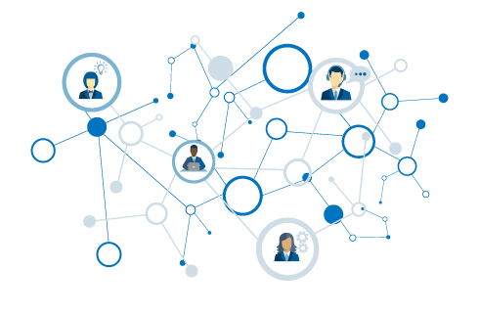
Popular Pythonistas
What is a network?
Building graphs
Who’s who in PyNash?

Slide 4
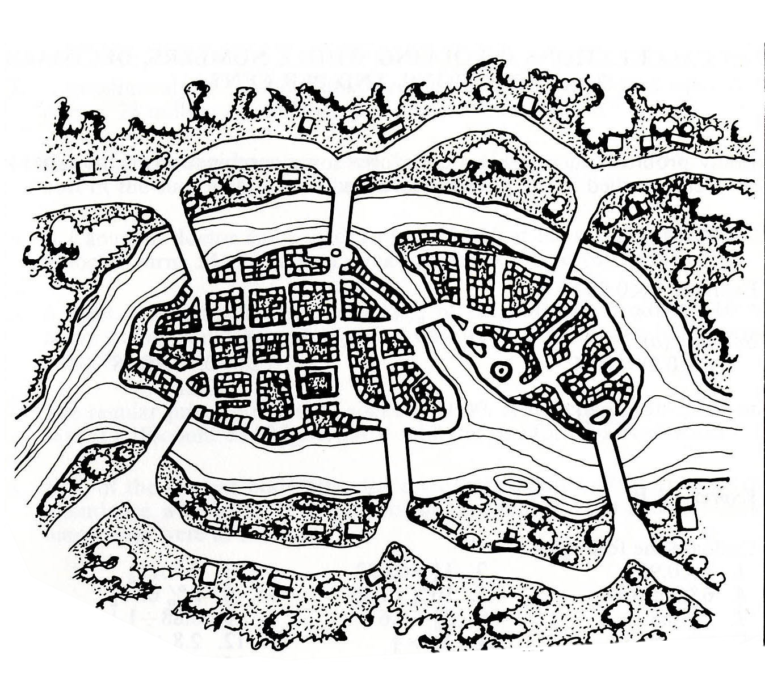
Can you traverse every bridge just once?
2
1
3
4
5
6
7

Slide 5
A
2
1
3
C
B
4
5
6
7
D

Slide 6
Graph
A
Node
B has the most connections
B
C
Edge
D
A & D are on the “outside” – they are not connected to each other
Notes:
Without knowing anything about this system, what is one thing you might say?
B seems to be the most “important” place – has the most connections.
B and C are seem to be more central to the graph – A and D are both on the edges

Slide 7
1
1
To travel into AND out of a node, requires 2 steps (or 4 or 6…).
Therefore… either:
All nodes are even.
Exactly two nodes are odd.
2
2
1
3
2
Notes:
Without knowing anything about this system, what is one thing you might say?
B seems to be the most “important” place – has the most connections.
B and C are seem to be more central to the graph – A and D are both on the edges

Slide 8
Back to Konigsberg…
3
5
3
Four nodes with odd number of edges!
3
Notes:
Without knowing anything about this system, what is one thing you might say?
B seems to be the most “important” place – has the most connections.
B and C are seem to be more central to the graph – A and D are both on the edges

Slide 9
That’s the ticket…
3
4
3
2
Notes:
Without knowing anything about this system, what is one thing you might say?
B seems to be the most “important” place – has the most connections.
B and C are seem to be more central to the graph – A and D are both on the edges

Slide 10
Graphs
Useful for understanding relationships.
Describe topology (arrangement) of networks.
Many possible measurements to derive.

Slide 11
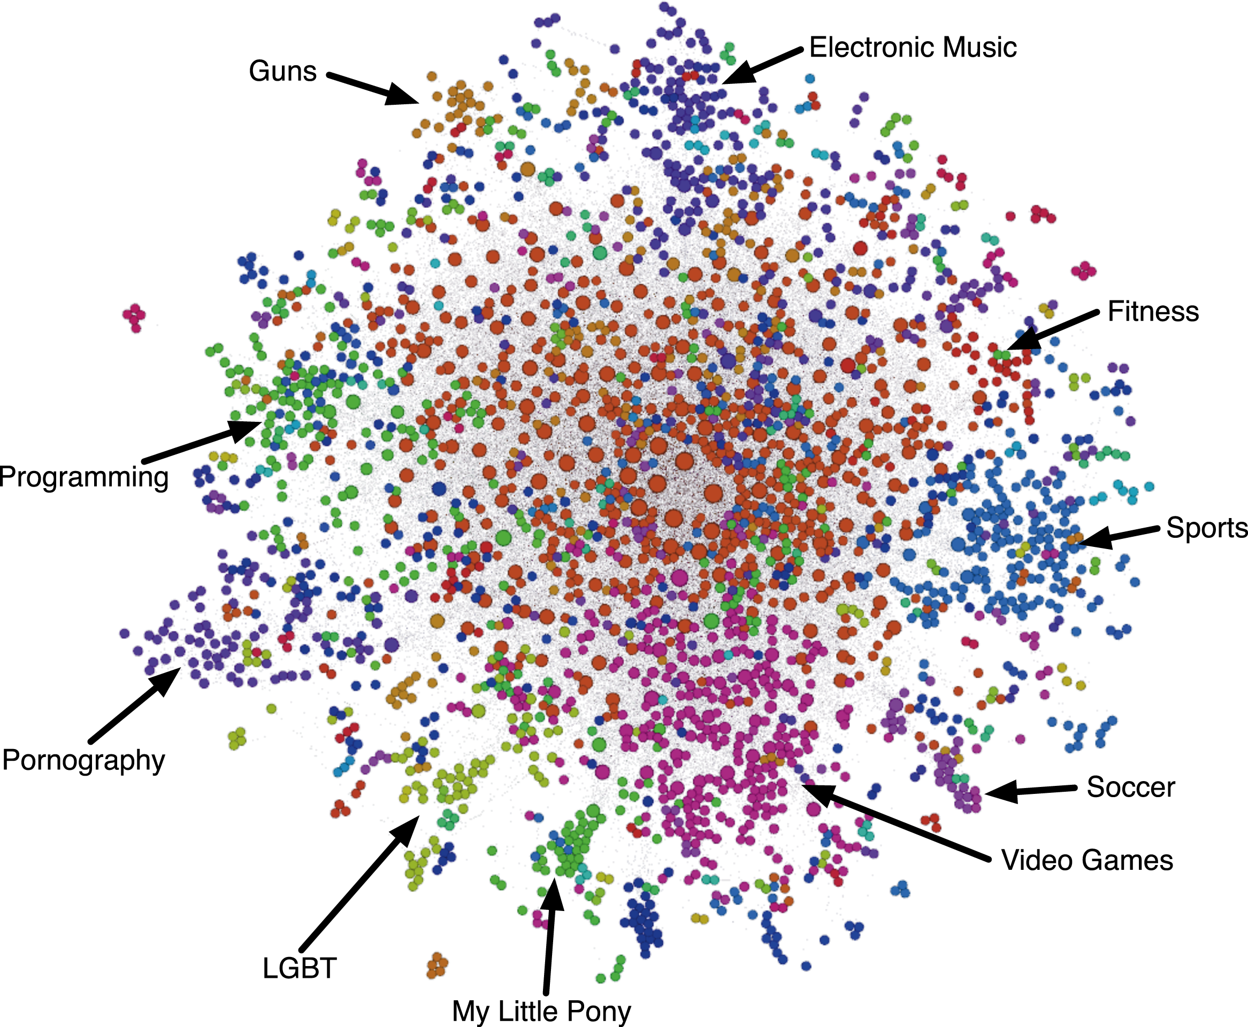
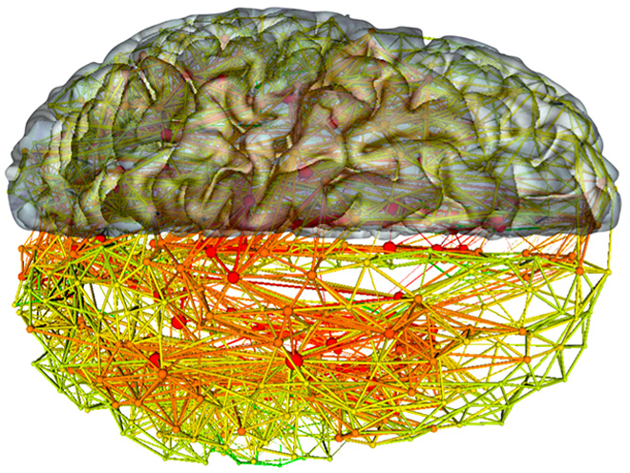
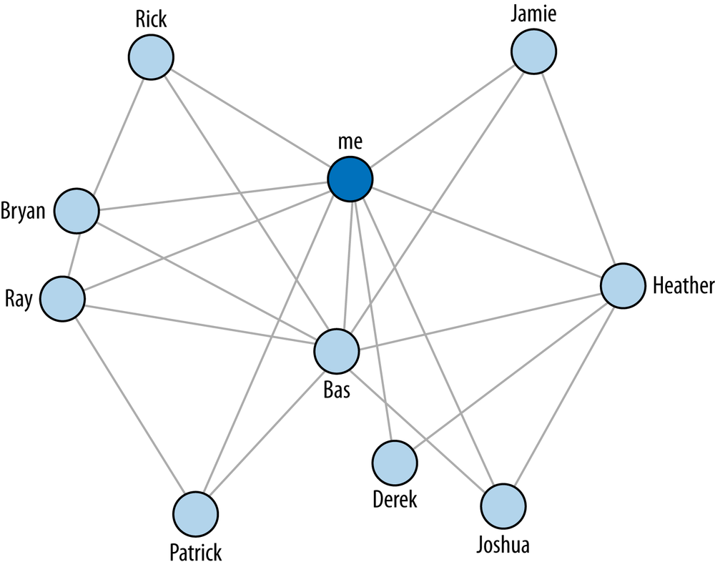
Notes:
Without knowing anything about this system, what is one thing you might say?
B seems to be the most “important” place – has the most connections.
B and C are seem to be more central to the graph – A and D are both on the edges

Slide 12
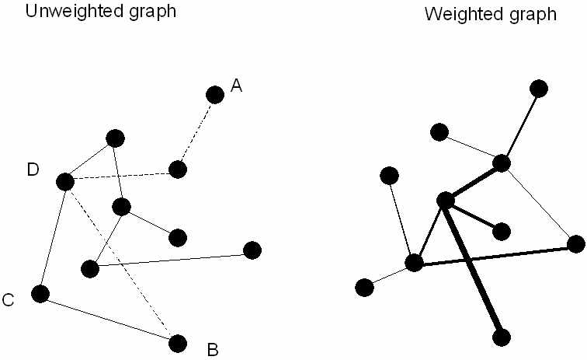
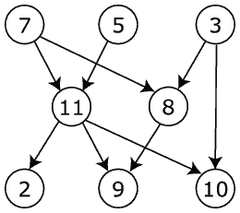
Multiple possible graph types
UNDIRECTED
DIRECTED
Notes:
Simplest would be unweighted, undirected

Slide 13
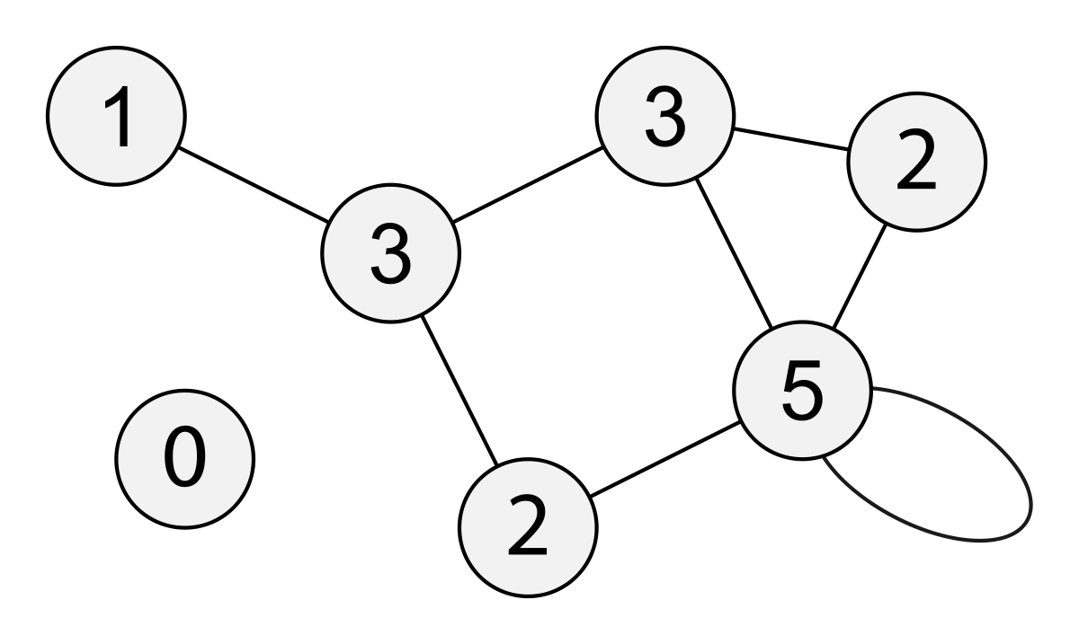
Common Measures
Degree
Notes:
Path length – average

Slide 14
Common Measures
Degree
Path Length
Notes:
Path length – average

Slide 15
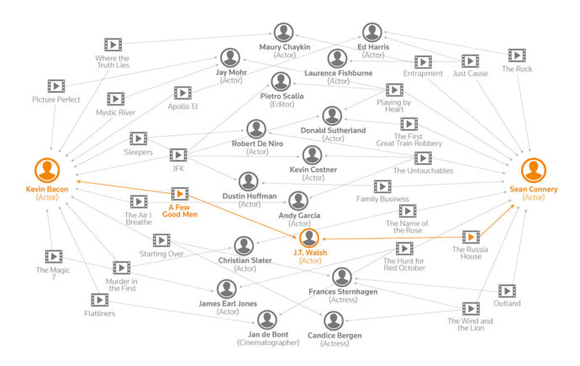

Slide 16
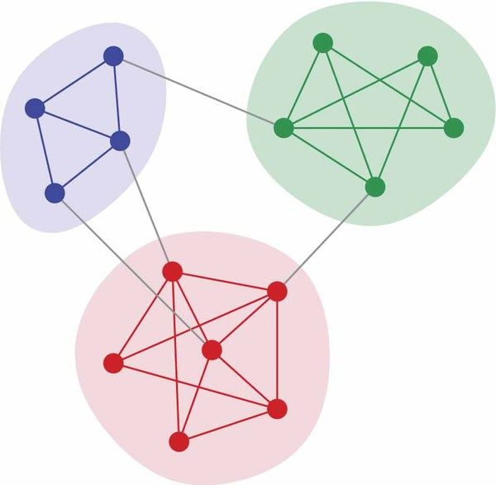
Common Measures
Degree
Path Length
Clustering
Notes:
Path length – average

Slide 17
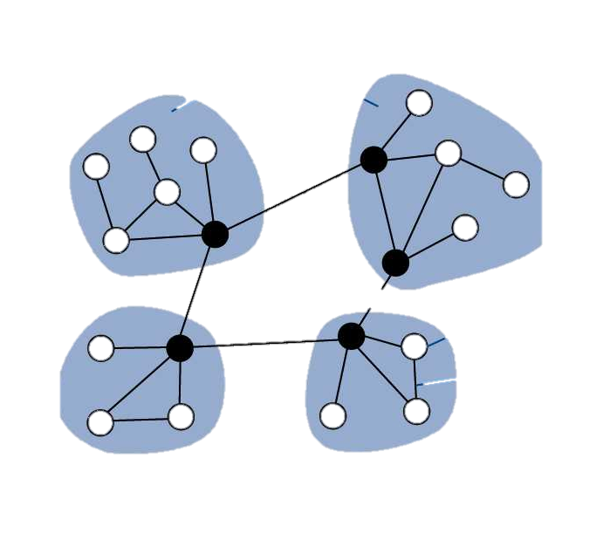
Common Measures
Degree
Path Length
Clustering
Centrality
Notes:
Path length – average

Slide 18
Graphs as matrices
A
B
C
 | A | B | C | D
A | - | 2 | 1 | 0
B | 2 | - | 1 | 2
C | 1 | 1 | - | 1
D | 0 | 2 | 1 | -
D

Slide 19
Popular Pythonistas
What is a network?
Building graphs
Who’s who in PyNash?

Slide 20
Guiding Question: Who are PyNash’s “glue guys/gals”?

Slide 21

The MeetUp Data
Used MeetUp API to get the following information:
All groups within 25 miles of Nashville.
All members of those groups.
All events for each group and who RSVPed yes.
(Everything is on Github)

Slide 22
PyNash Relationships
We have >1400 members. But not all of them come to every meeting. (And many don’t come to any meetings.)
So we want to build a graph where…
each node is EITHER a person or event
Each edge represents attendance at that event

Slide 23
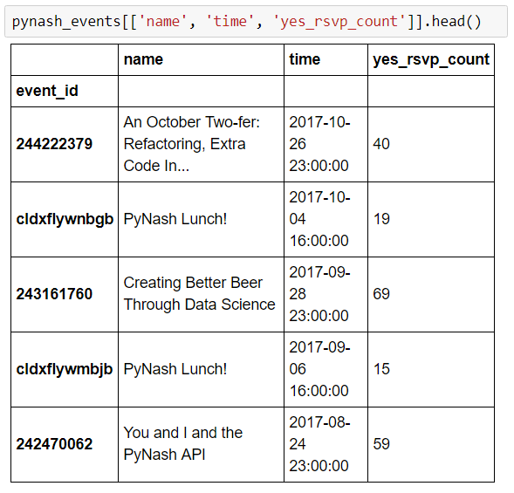
Building a graph: Event data

Slide 24
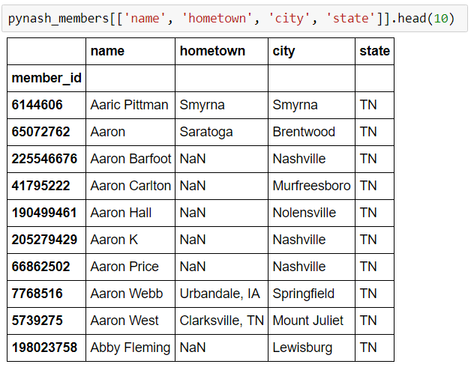
Building a graph: Member data

Slide 25
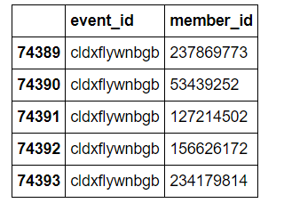
Building a graph: RSVP data

Slide 26
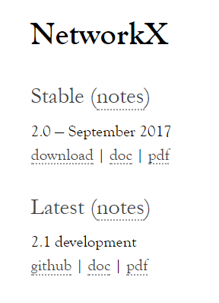
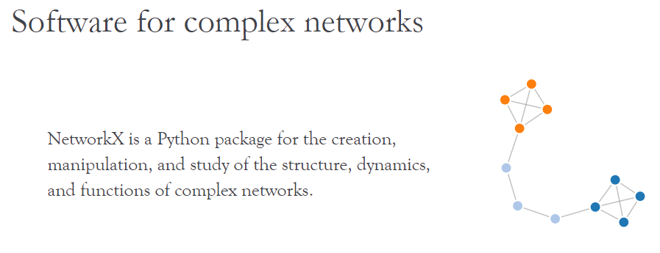
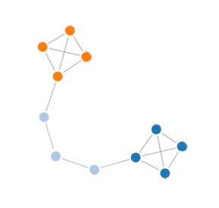

Slide 27
NetworkX Setup
Networkx functions
Graph methods / slicing
nx.Graph()
nx.DiGraph()
nx.degree(G)
nx.clustering(G)
nx.draw_networkx(G)
G.nodes()
G.edges()
G.degree()
G[node]
G[node][node]

Slide 28
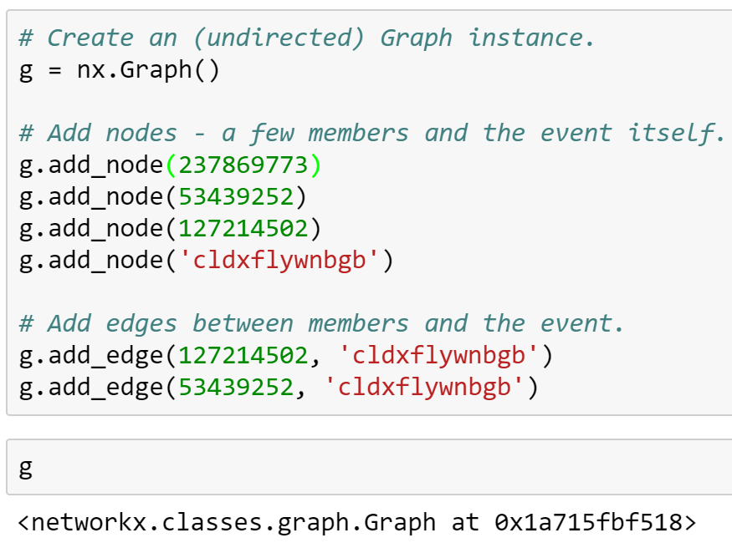
Building a graph: Declarative Syntax
G = nx.Graph()
G.add_node(237869773)
G.add_node(543492503)
G.add_node(234236034)
G.add_node(‘cldxflywnbgb’)
G.add_edge(237869773, ‘cldxflywnbgb’)
G.add_edge(543492503, ‘cldxflywnbgb’)

Slide 29
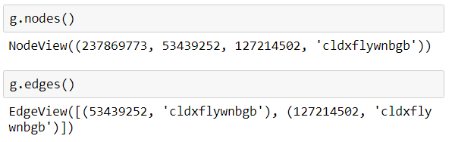
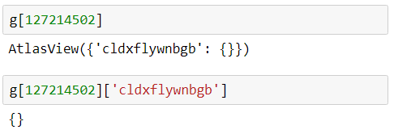
Slicing the graph
Graphs are setup as dicts-of-dicts-of-dicts.
Source: Target: Attrs

Slide 30
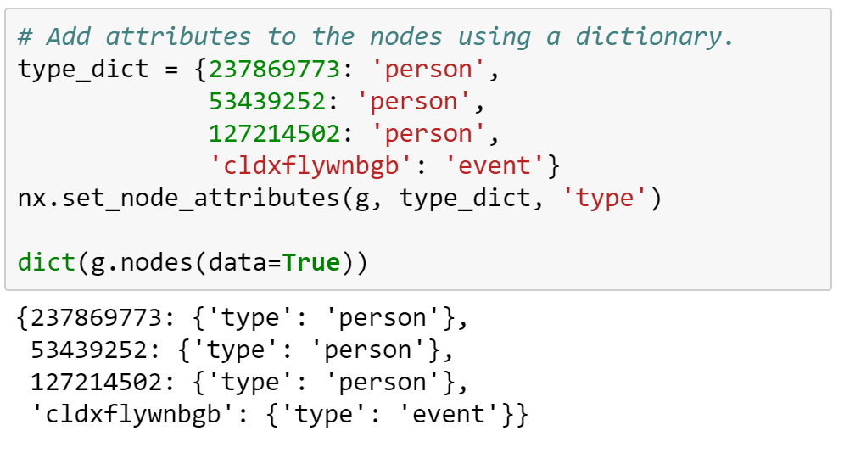
Adding attributes

Slide 31
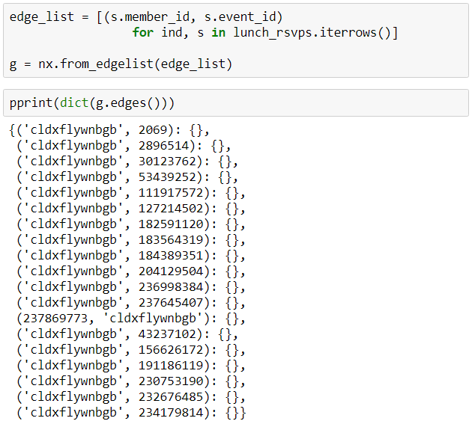
Building a graph: From list of edges

Slide 32
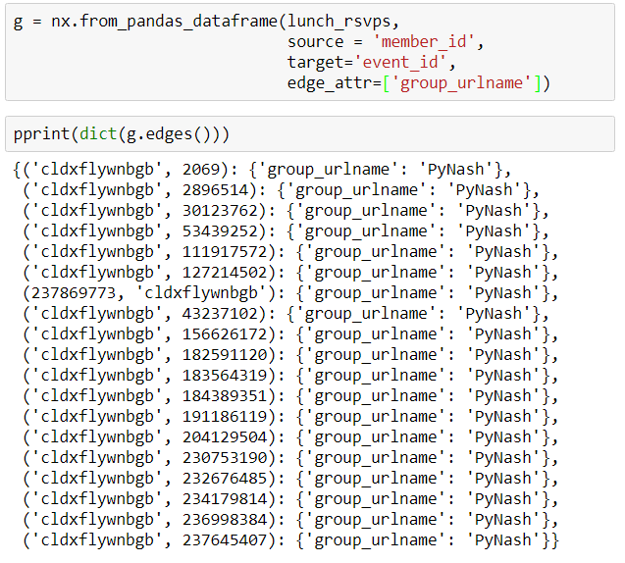
Building a Graph: From Pandas DF

Slide 33
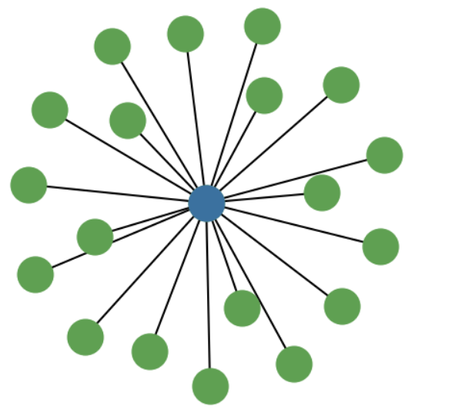
The lunch graph
Degree of the event = 19 (RSVPs)
Degree of the members = 1 (event attended)

Slide 34
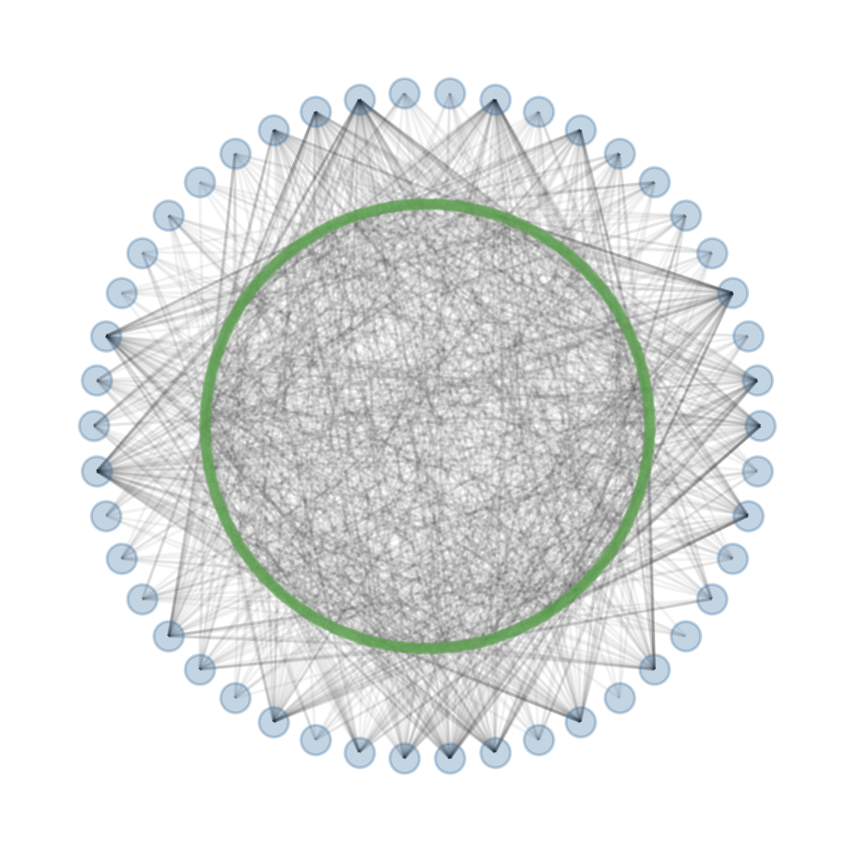
Scaling it up to all events

Slide 35
Popular Pythonistas
What is a network?
Building graphs
Who’s who in PyNash?

Slide 36
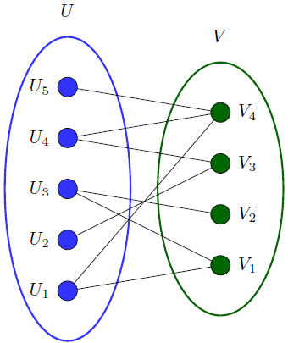
Bipartite Graphs
Great initial starting place for some datasets.
Can take the form of (Person node → Affiliation node)
e.g. (Sports fan → Sports team)

Slide 37
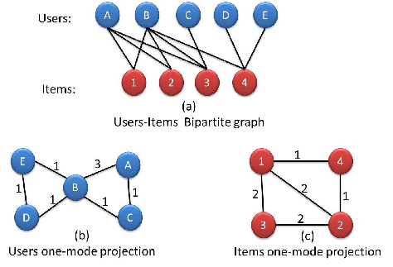
Projecting bipartiate graphs
We want to take
(Person, Event) to (Person, Person)

Slide 38
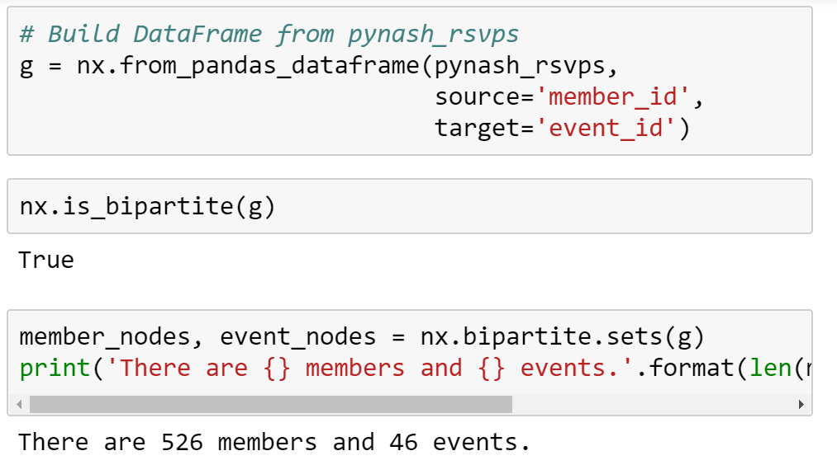
Building the PyNash Graph

Slide 39
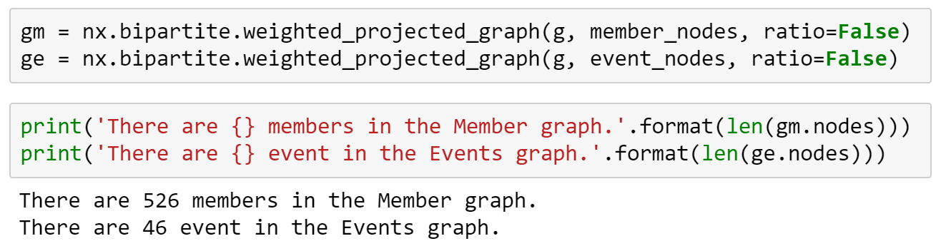
Projecting the graph

Slide 40
The “members” graph
Now we have a graph with the following attributes:
Node: a person who attended at least one event in the past two years
Edge: shared event between two people
Edge weight: the number of shared events
PyNash Lunch
Bill
W=1
Jake

Slide 41
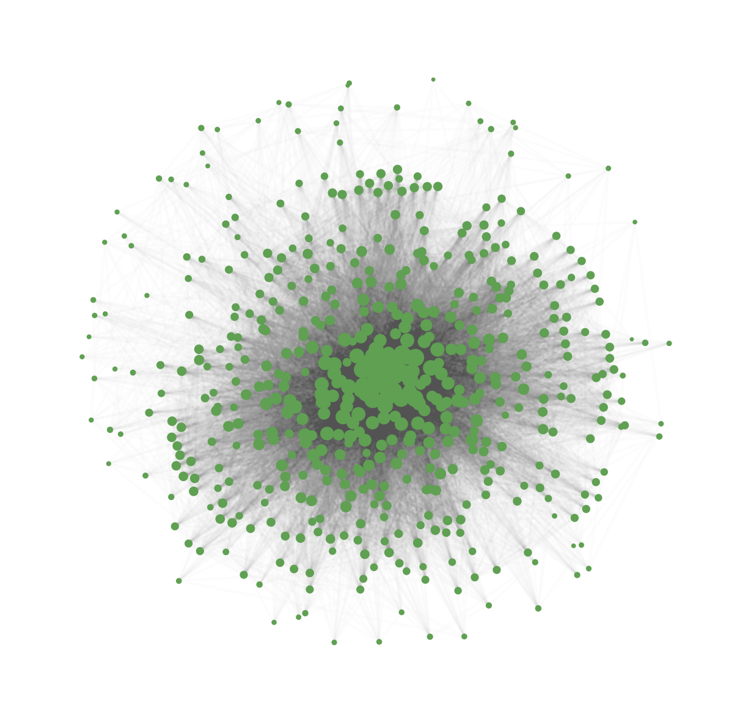
Member Structure
Defined by 1-2 events
Large “core” of highly connected individuals, with many others on the periphery.
Densely connected

Slide 42
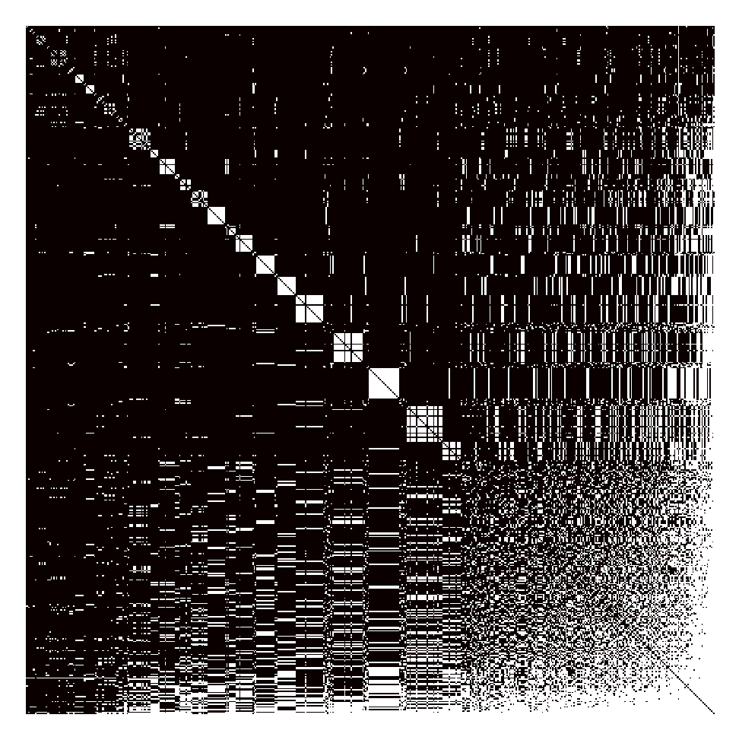
Adjacency Matrix
Matrix representation of graph edges
N*N binaray array

Slide 43
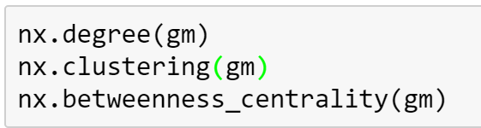
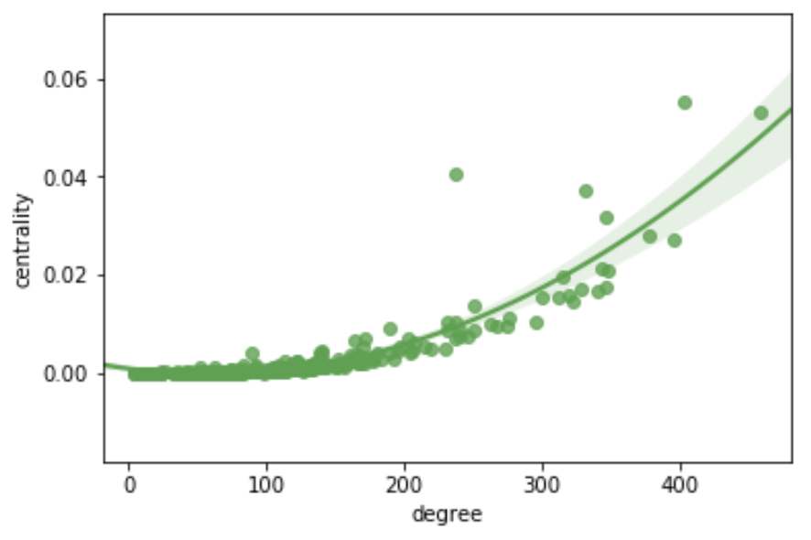
Getting network measures
Degree = number of members w/ shared attendance at an event
Centrality = how much a person “connects” two other people

Slide 44
*drumroll*

Slide 45
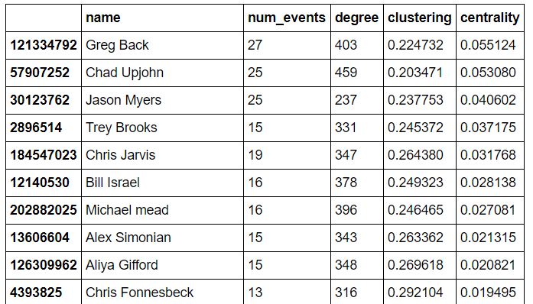
Our top “connectors”

Slide 46
Event Attendance for Upjohn and Myers
Chad Upjohn
degree = 459
Jason myers
Degree = 237
An October Two-fer: Refactoring, Extra Code Included / PDFs Against Humanity
Creating Better Beer Through Data Science
You and I and the PyNash API
PyNash x Penny U: An Evening of Learning
Interactive Python Environments: IPython, Jupyter, and Beaker, Oh My!
PyNash Lunch!
Logging beyond /dev/null -- ELK Stack for Log Visualization and Analysis
PyNash Lunch!
PyNash Lunch!
PyNash Lunch!
You and I and the PyNash API
PyNash Lunch!
PyNash Lunch!
PyNash Lunch!
PyNash Lunch!
PyNash Lunch!

Slide 47
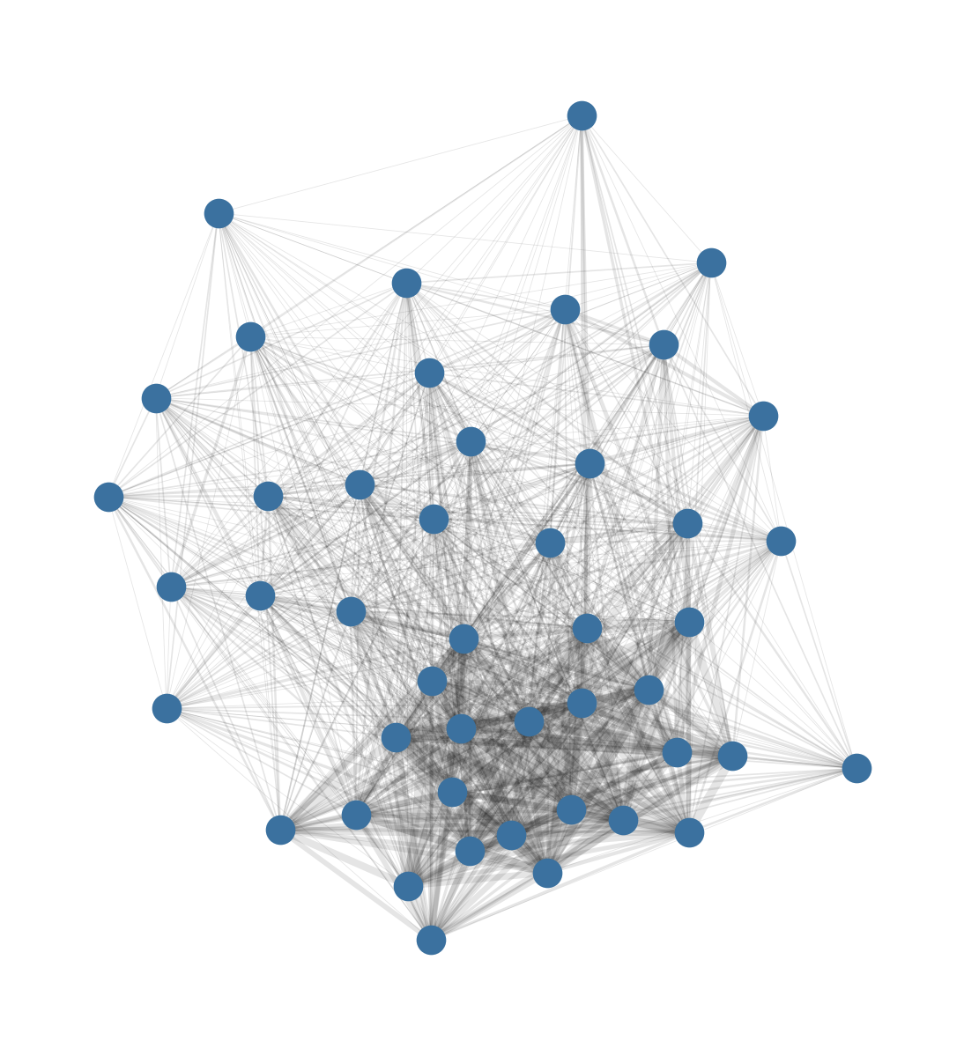
What about the events?
Lunches
Talks

Slide 48
Now, to Nashville!

Slide 49
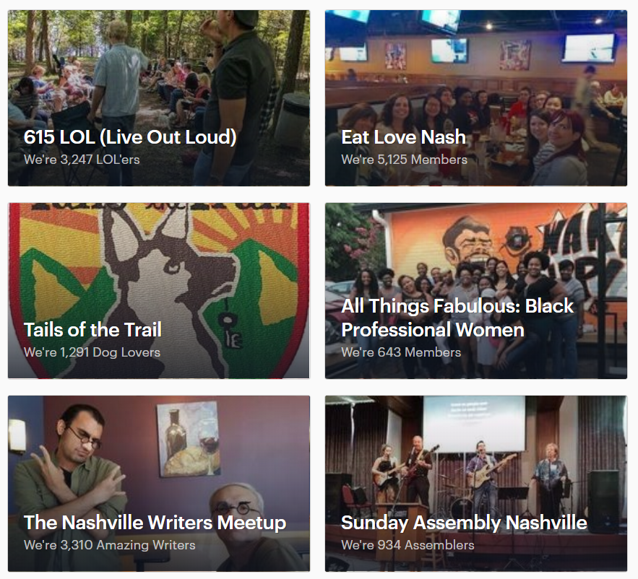
Making a splash
We now know who to get in touch within PyNash – but what about outside of PyNash?
There are likely going to be clusters of groups
- Tech groups
- Outdoors groups
- Professional groups

Slide 50
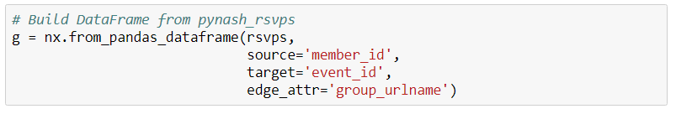
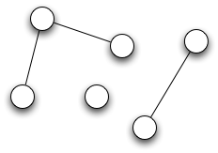
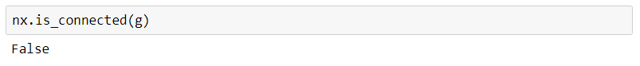
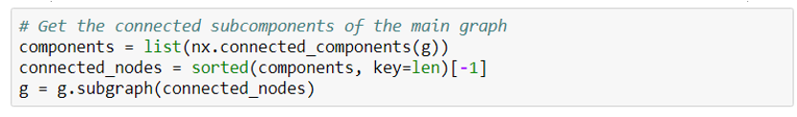
A new problem!!

Slide 51
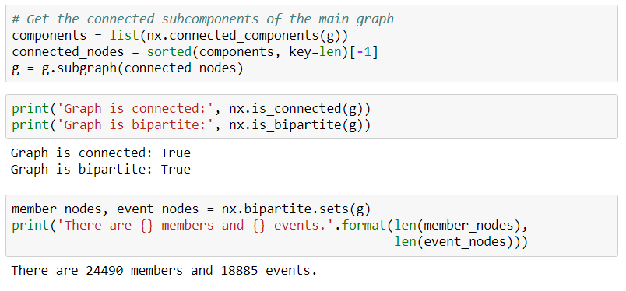

Slide 52
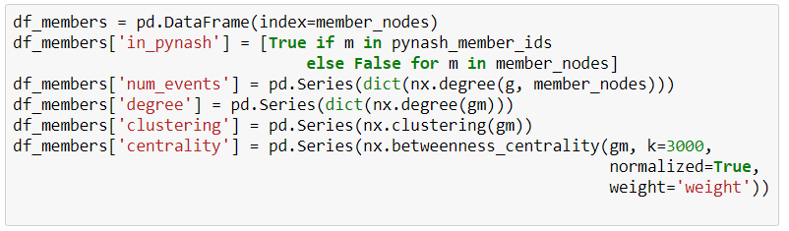
Creating a metric DataFrame
Takes a LONG time – can be parallelized.

Slide 53
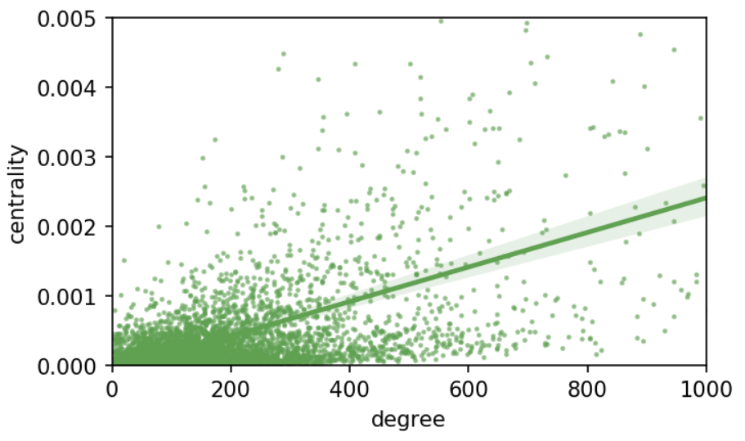
In larger networks, there is a weaker relationship between degree and centrality
Notes:
You might attend a lot of events with people, but you may not be getting out of your “bubble” – you might go to a lot of tech events, for example.

Slide 54
The best networked in the room are…
Bryan Overbey
Hameed Gifford
Jeremy
Josh E
Aliya Gifford
Kadu
Trev Lawson
Wayne Martin
Weston Hunter
Kate Brady

Slide 55
The best networked in the room are…
Bryan Overbey (129122472) has attended 27 events total in 22 different groups.
They have attended PyNash 1 time(s).
Top attendance:
- Nashville-Sailing: 5
- steppingoutsocialdance: 2
- Nashville-Free-Guitar-Lesson-Meetup: 1

Slide 56
The best networked in the room are…
Hameed Gifford (43237102) has attended 29 events total in 15 different groups.
They have attended PyNash 6 time(s).
Top attendance:
- PyNash: 6
- Nashville-soccer: 5
- nashjs: 3

Slide 57
The best networked in the room are…
Josh E (55029192) has attended 55 events total in 10 different groups.
They have attended PyNash 13 time(s).
Top attendance:
- PyNash: 13
- NashvilleMobileDotNet: 10
- Nashville-NET-User-Group: 9

Slide 58
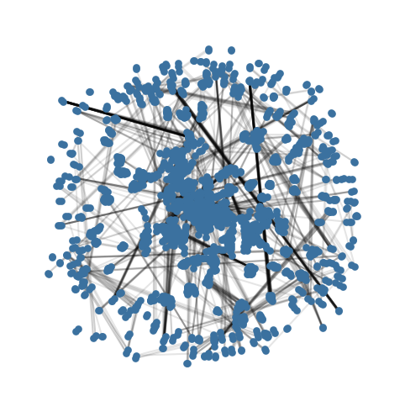
How about the groups?
Event projection – edges represent shared members.
High degree for an event means it has (at least one) shared attendees with a lot of other events.
Low clustering means that it does not draw from the same pool of shared attendees each time.
Aggregated events by group and summarized!

Slide 59
Lowest Clustering
(Most “new people”)
Highest Degree
(most Shared Attendance)
MusicCityDrinkingBuddies
Movie-Lovers
Nashville-Psychotherapy-Institute
SavvyCoders
Tennessee-Real-Estate-Investors
Free & Cheap Events
NashvilleMusician
funhappeningssocialgroup
paddleadventuresunlimited
nashjs
MTN-40
Nashville-NET-User-Group
Sunday-Assembly-Nashville
dnd-49
nashville-ux
Data-Science-Nashville
NashvilleFlagFootball
steppingoutsocialdance

Slide 60
The big picture
Applications
Limitations
Recommendation engine – based on your interests, who might you connect with?
Social status measures beyond “number of events” attended.
Target “influential” people for advertising / recruiting.
This data is based on “rsvps” – may not reflect real attendance.
Attendance =/= participation
Wide number of connections does not represent influence – though it may represent persistence.

Slide 61
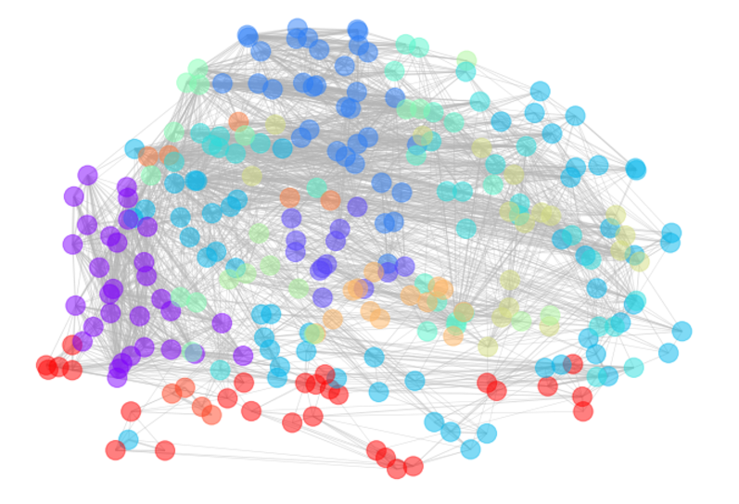

Slide 62
Recap of NetworkX
Build graphs
Indexing graphs
g = nx.Graph()
g = nx.DiGraph()
nx.from_edge_list()
nx.from_pandas_dataframe()
n = g[node]
e = g[node][node]
w = g[node][node][attribute]
[n for n in g.nodes]
[e[‘weight’] for e in g.edges]

Slide 63
Recap of NetworkX
Build graphs
Draw Graphs
nx.degree(g)
nx.betweenness_centrality(g)
nx.clustering(g)
pos = nx.spring_layout(g)
pos = nx.circular_layout(g)
nx.draw_networkx(g, pos)

